Slide 1
Chapter 8 Understanding Relationships
MGCR 222 - Introduction to Organizational Behaviour
Maya Sharma

Slide 2
Learning Objectives
1.Politics
Discuss Organizational Politics and Its Effects On an Organization
2.Trust
Explain the Importance of Trust in the Workplace and Ways to Build Trust in the Workplace
3. Fairness
Recognize How Fairness Promotes Positive Feelings, Improves Satisfaction, Promotes Organizational Citizenship Behaviour and Reduces Turnover
4. Negotiation
Discuss Negotiation as an Everyday Occurrence in Organizational Relationships
5. Conflict
Understand how to address conflicts
Notes:
We will discuss the causes and consequences of power and politics which is often self- serving behhaviours
and explore the counterbalancing relational concepts of trust, fairness and integrative negotiation

Slide 3
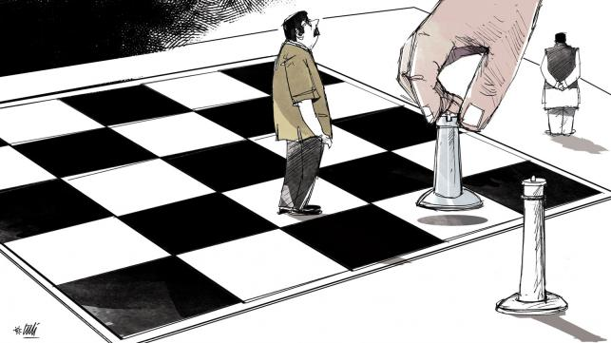
What Is Organizational Politics?
Activities that individuals in organizations pursue to reach their own desired outcomes (which may or may not be in the interests of the organization).
Requires the use of Power

Slide 4
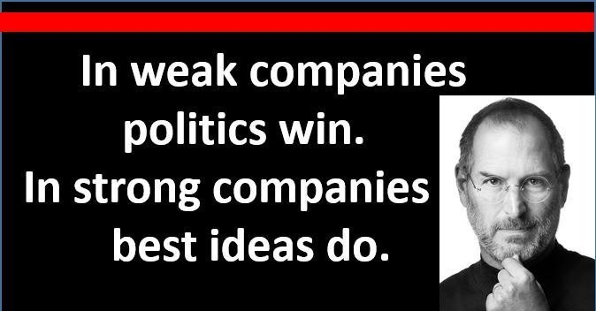
Organizational Politics & Its Impact

Slide 5
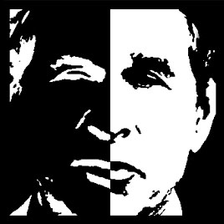
Two Faces of Power
Personal Power (Power over)
Used for personal gain or power hungry
Some are Machiavellian
Social Power (Power To)
Used for the good of the group, to create motivation, to accomplish group goals

Slide 6
What are the Traits of Powerful & Powerless Leaders?
Powerful Leaders “ Power To”
Delegate decision making authority
See people’s talents as an asset
Improve employee working conditions
Secure resources and strategic information for the team
Take calculated risks
Press for innovations
Share power with subordinates
Help develop people
Powerless Leaders “Power Over”
Supervise closely
Do not delegate decisions
Distrust subordinates
See people’s talents as a threat
Focus on rules
Are risk averse
Emphasize work over well being
Protect their territory/sand box

Slide 7
Types of Organizational Politics
Blaming
Deception
Types of
Organizational
Politics
Withholding
information
Breaking
Promises
Trade Favours &
Bargaining
Forming coalitions

Slide 8
Conditions For Organizational Politics
Lack of resources
High levels of distrust
Shifts In power
Political Organizational Culture
Democratic, Complex or ambiguous decision making processes
Personal Traits:
High Need for Power, Machiavellian Personality, Internal Locus of Control

Slide 9
Two Approaches to Organizational Politics
Conventional
Approach
Sustainable Approach

Slide 10
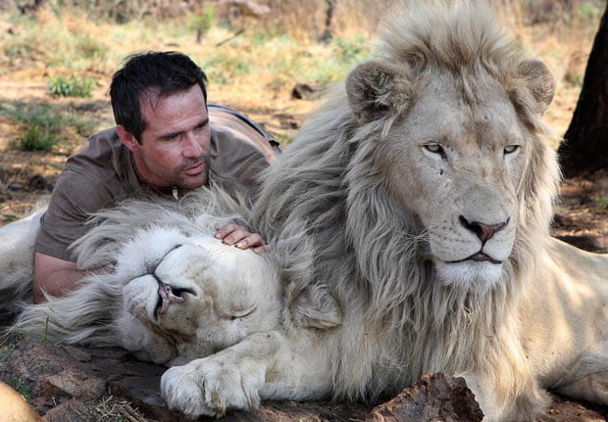
Trust
Elements of a Trusting Relationship: Interpersonal Trust, Psychological Contract and Social Networks
Interpersonal trust -the “expectation, assumption, or belief about the likelihood that another’s future actions will be beneficial, favourable, or at least not detrimental to one’s interests.”
Psychological contract
Impact of trust in
organizations

Slide 11

Social Networks Are Built on Trust
Interactions among members are deemed trustworthy if the following characteristics are demonstrated:
Competence
Character
Goodwill

Slide 12
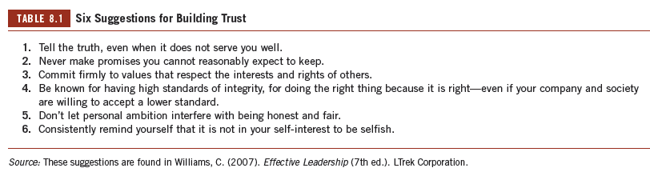
Suggestions For Building Trust

Slide 13
Delegation
What is Delegating?
Delegating is the process through which a person, usually an organizational leader, trusts direct reports, followers, or even peers to accomplish a task or organizational objective.
When to Delegate or not?
5 Steps Of Conventional and Sustainable Delegation (Read On Your Own)

Slide 14
Fairness (Covered in Chapter 5)
What is Fairness?
A judgment about whether treatment has been just, equitable, and impartial.
Counterforce to politics
Affects trust
Distributive, Procedural, Interactional Justice
Nepotism

Slide 15
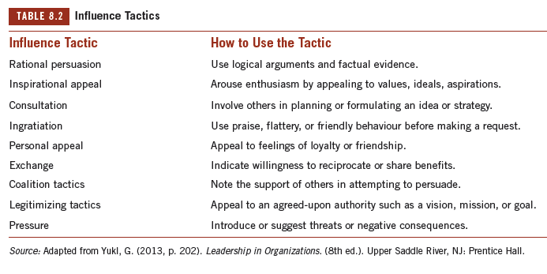
Influence Tactics

Slide 16
Negotiation
What is Negotiation?
Is a social interaction between two (or more) parties who attempt to persuade or influence each other regarding a specific end.
Negotiation outcomes affected by:
Influence Tactics
Approaches To Negotiation
Conflict Styles

Slide 17
Objectives and Skills Of Negotiations
The Objective of Negotiation Is To:
Come to an Agreement Over The Issue;
Understand What The Other Party Really Wants;
Communicate And Persuade.
What OB Skills Are Applied in Negotiations?
Communication
Perceptions
Decision Making
Motivation
Power, Influence Tactics

Slide 18
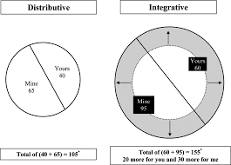
Approaches to Negotiation
Distributive (single issue)
Competitive approach: Win-lose
Maximize My Gains
Fixed
Conventional Approach
Integrative (multi-issues)
Win/Win
Maximize Both Parties’ Gains
Expandable
Sustainable Approach

Slide 19
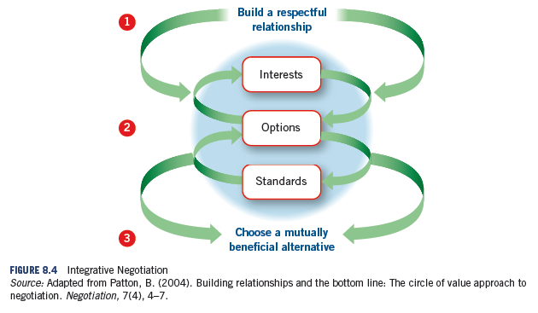
Steps in Integrative Negotiation

Slide 20
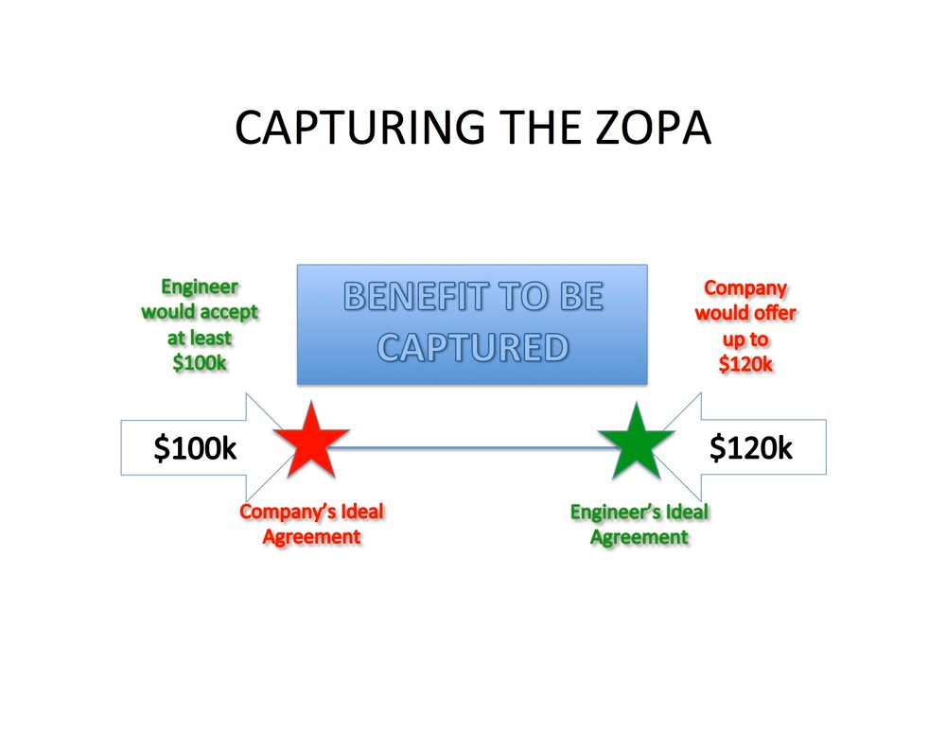
ZOPA- Zone of Possible Agreement

Slide 21
Employment Offer Negotiation – Key Terms
Opening Offer- Making the first offer serves as an anchor
Anchor- reference point around which a negotiation will revolve and will be used to make negotiation adjustments.
Best alternative to a negotiated agreement (BATNA) is having other options than accepting an undesirable outcome.
Aspiration Point- is what you hope for in a given negotiation (desired outcome)
Reservation/ Resistance Point - Bottom Line
ZOPA (Bargaining Zone): is a range of possible offers you and the other party are willing to accept

Slide 22
Key Negotiation Takeaways
Make sure you are both satisfied
What is a good outcome for the parties?
Discuss and ask questions
Preserve the relationship, maintain a long term perspective
Come prepared! Both sides need to know their numbers
Manage perceptions & ego

Slide 23
Negotiation Mistakes
Viewing negotiation as a fixed pie
Over-valuing your assets
Going on a power trip
Not knowing what you really want
Binding yourself too tightly to a particular outcome
Lacking cultural awareness/intelligence

Slide 24
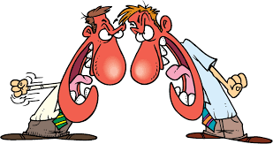
Conflict Defined
What is a conflict?
Dysfunctional And Functional

Slide 25
2 Types of Organizational Conflict
Cognitive/ Task related
Conflict relates to differences in perspectives and judgments
Task or process oriented
Involves disagreement about the work that is being done
Usually functional conflict
Affective/ Relationship
interpersonal conflicts (dislike for person)
Dysfunctional conflict
One can lead to the other!

Slide 26
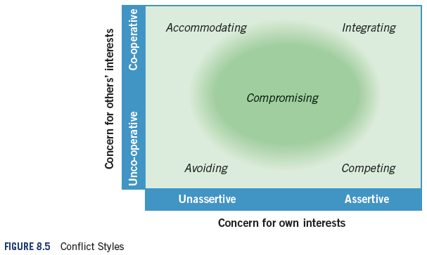
Conflict Styles

Slide 27
5 Conflict Styles
Competing
Imposing one’s will on the other party.
Collaborating/ Integrating
Win-win approach.
Avoiding
The desire to withdraw from or suppress a conflict.
Accommodating
Accepting and incorporating the will of the other party.
Compromising
A situation in which each party to a conflict is willing to give up something.

Slide 28
Key Terms
Aspiration point
is what you hope for in a given situation; it is your preferred result.
Best alternative to a negotiated agreement (BATNA) is having other options than accepting an undesirable outcome.
Conflict style
is the way people handle conflict.
Delegating
is the process through which a person, usually an organizational leader, trusts direct reports, followers, or even peers to accomplish a task or organizational objective.
Distributive bargaining
assumes there is a limited amount of money, resources, or opportunities that must be divided up through negotiation because people have competing interests.
Distributive justice
compares the individual’s inputs and outcomes to other members’ inputs and outcomes.
Fairness
is a judgment about whether treatment has been just, equitable, and impartial.
Influence tactics
are specific behaviours exercised to achieve an outcome, particularly getting personal interests satisfied.

Slide 29
Key Terms
Integrative negotiation
is an alternative to distributive bargaining that seeks to achieve a win-win result for both parties.
Interactional justice
is the interpersonal form of justice concerned with the behaviour of leaders in their relationship to followers or direct reports.
Interpersonal trust
consists of the expectation, assumption, or belief about the likelihood that another’s future actions will be beneficial, favourable, or at least not detrimental to one’s own interests.
Negotiation
is a social interaction between two (or more) parties who attempt to persuade or influence each other regarding some end.
Organizational politics
refers to the activities that individuals in organizations pursue to reach their own desired outcomes.
Psychological contract
is an unwritten expectation about the exchanges that will take place between an employee and the organization.
Social networks
are patterns of repeated interactions that influence the flow of resources, information, and support among organizational members.
Zone of possible agreements (ZOPA)
is a range of possible offers you and the other party are willing to accept.

Slide 30
Next Steps
Chapter 11: Communicating With A Purpose

